Slide 1


Collecting, annotating and integrating PPI data: standards initiatives, data formats and data models
Course on Protein Networks and Systems Biology (Bologna, 14-18 December2015)
Speaker: Luana Licata, MINT, University of Rome Tor Vergata

Slide 2
Course on Protein Networks and Systems Biology
Session Outline
Collecting and annotating PPIs data
Integrating PPIs data
Molecular Interaction Standards
PSI-MI XML format
tab-delimited format, MITAB
PSI-MI standard data tools
Web resources describing results of PPI experiments

Slide 3
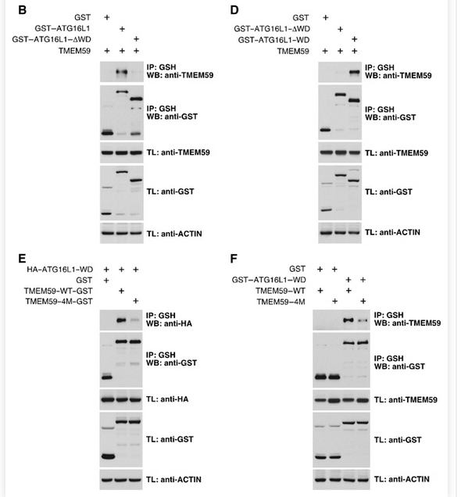
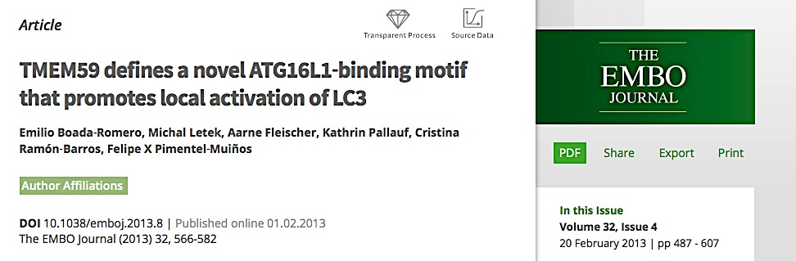
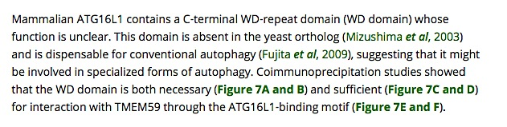
Course on Protein Networks and Systems Biology
Collecting and annotating PPI data
PMID: 23376921
FIGURE 7

Slide 4
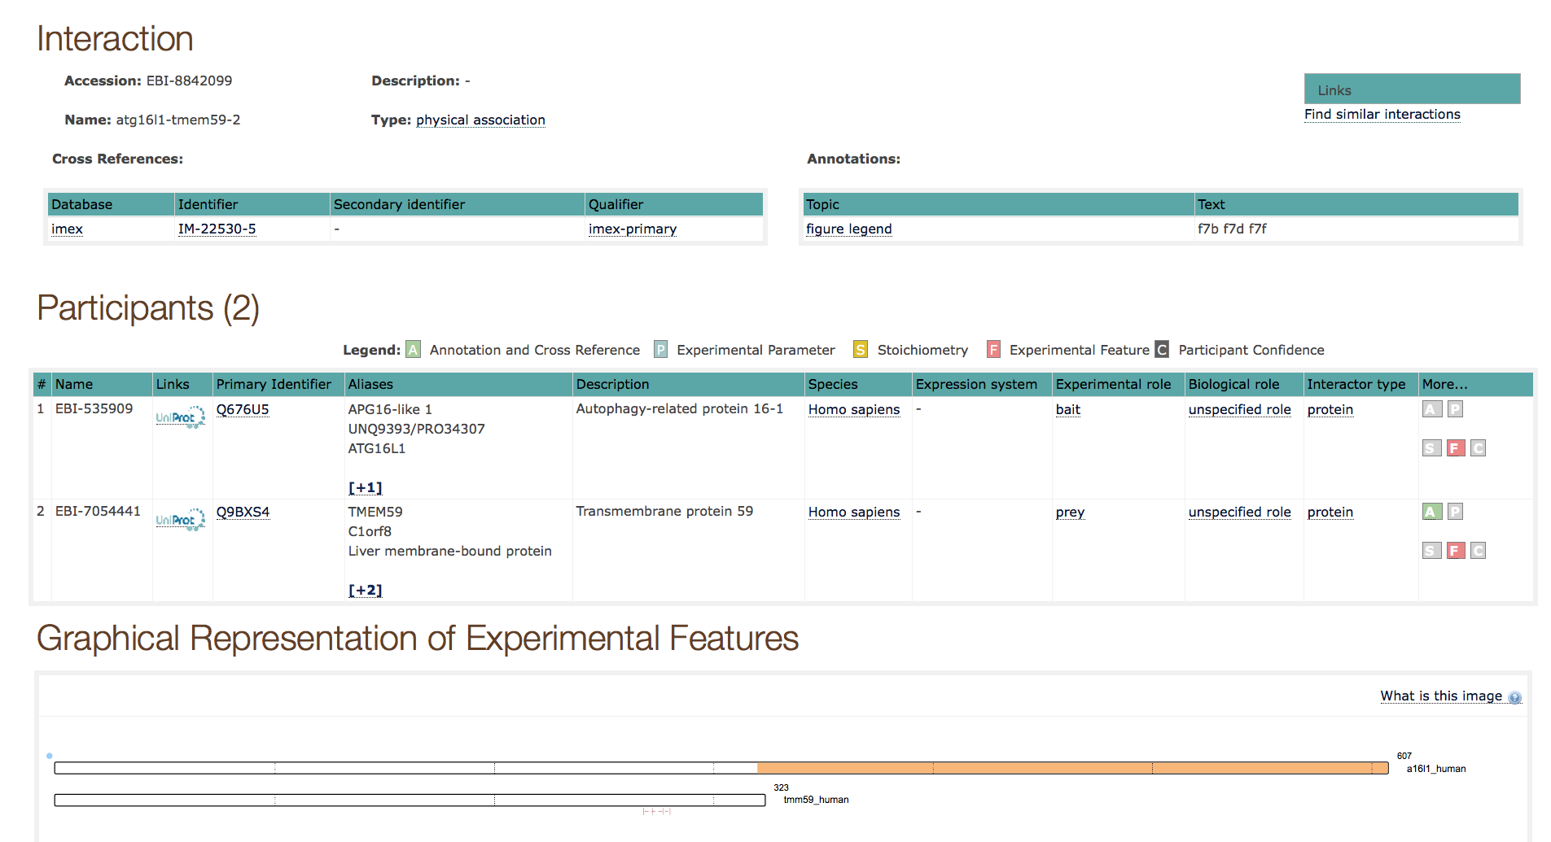
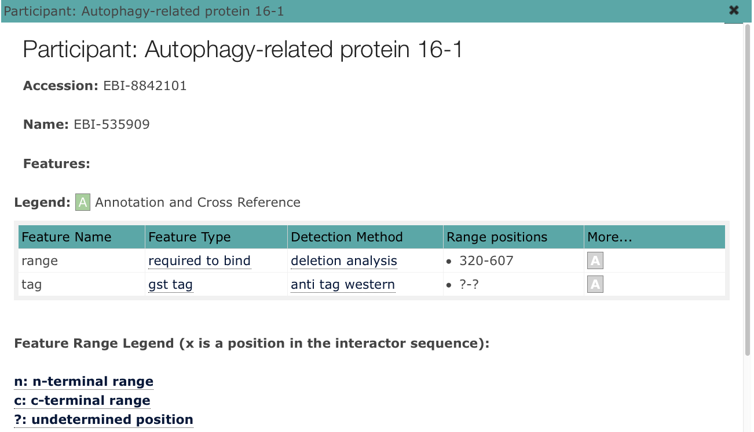
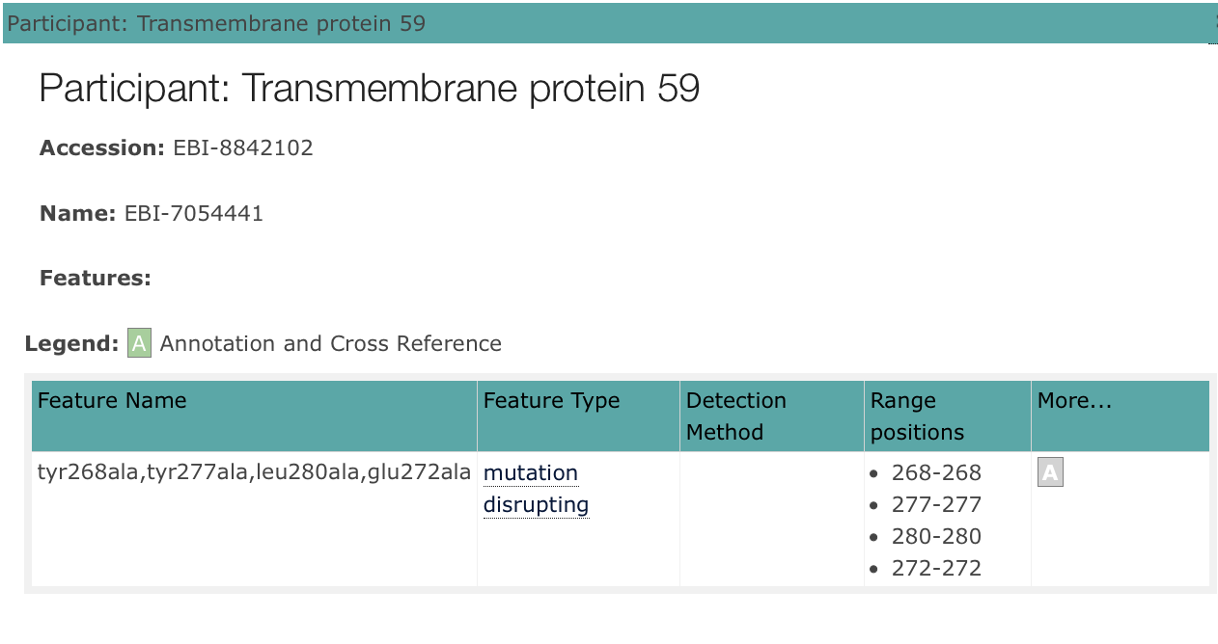
Course on Protein Networks and Systems Biology

Slide 5
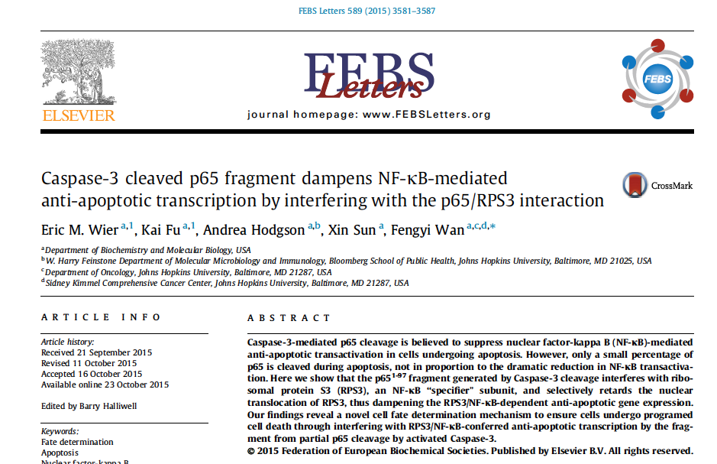
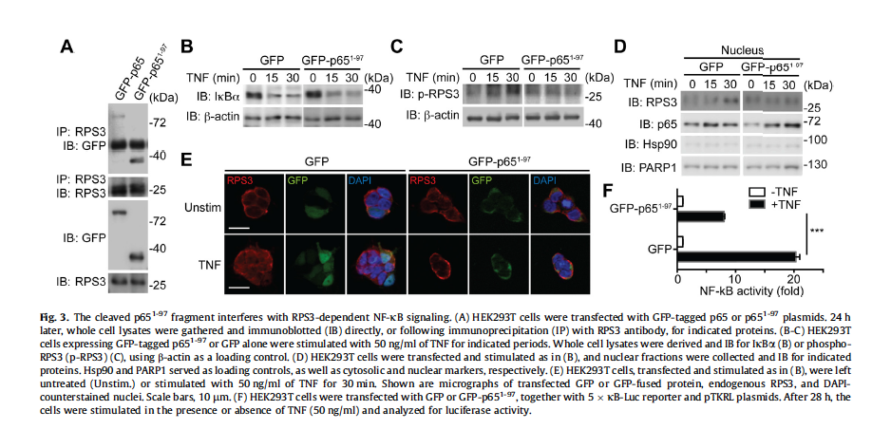
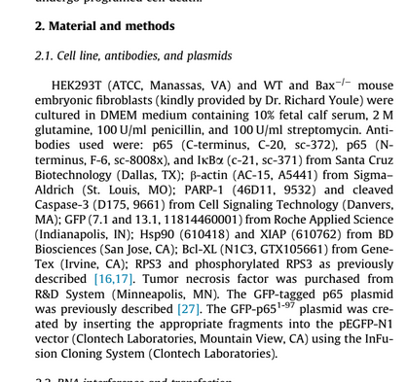
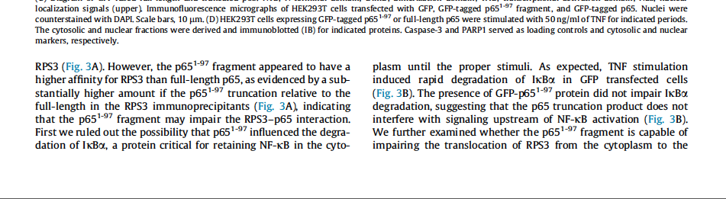
Course on Protein Networks and Systems Biology
ANNOTATION EXAMPLE
Notes:
PMID: 26526615

Slide 6
Course on Protein Networks and Systems Biology
Molecular interaction standards
The first molecular interaction databases independently established their own dataset formats and curation strategies:
mass of heterogeneous data
very complicated to use
interpretable by bioinformaticians after downstream meticulous work (reformatting data before merging, data loss after file conversions
The molecular interaction repositories community recognised that it was necessary to move toward unification and standardization of PPI data.

Slide 7


Course on Protein Networks and Systems Biology
PSI-MI XML format
In 2002, The HUPO-Proteomics Standards Inititative (HUPO-PSI ) defines
community standards for data representation in proteomics to
facilitate data comparision, exchange and verification.
Developed by major data providers: MINT, IntAct, DIP, DIP, BIND, CellZome, MIPS, Serono, GSK, HPRD, Hybrigenics U. Bielefeld, U. Bordeaux, U. Cambridge, and others
Version 1.0 was published in February 2004 The HUPO PSI Molecular Interaction Format - A community standard for the representation of protein interaction data. (Henning Hermjakob et al, Nature Biotechnology 2004, 22, 176-183.)
Version 2.5 published in October 2007 Broadening the Horizon – Level 2.5 of the HUPO-PSI Format for Molecular Interactions; (Samuel Kerien et al. BioMed Central. 2007. )

Slide 8
Course on Protein Networks and Systems Biology
PSI-MI XML schema
Development of PSI-MI XML schema has facilitated the description of interactions and the details of information to capture, such as:
Biological role of partecipants
mapping of interacting domains
kinetic parameters
Stoichiometry
The PSI-MI XML format is a powerful mechanism for data exchange between multiple sources molecular interaction resources.
Data can be integrated, analysed and visualised by a range of software tools.
An Excel-compatible, tab-delimited format, MITAB, has been developed for users who require only minimal information but in a more accessible configuration.

Slide 9
Course on Protein Networks and Systems Biology
PSI-MITAB COLUMNS
MI-TAB 2.5 STANDARD
COLUMNS (15)
ID(S) INTERACTORS
ALT. ID(S) INTERACTORS
ALIAS(ES) INTERACTORS
INTERACTION DETECTION METHOD(S)
PUBLICATION FIRST AUTHOR(S)
PUBLICATION IDENTIFIER(S)
TAXID INTERACTORS
INTERACTION TYPE
SOURCE DATABASE(S)
INTERACTION IDENTIFIER(S)
CONFIDENCE VALUE(S)
MI-TAB 2.7 STANDARD
COLUMNS (+27)
EXPANSION METHOD(S)
BIOLOGICAL ROLE(S)
EXPERIMENTAL ROLE(S)
TYPE OF INTERACTORS
PROPERTIES (CROSSREFERENCES) OF
INTERACTORS/INTERACTION
ANNOTATION OF INTERACTORS/INTERACTION
HOST ORGANISM(S)
PARAMETER OF INTERACTION
FEATURE(S) INTERACTORS
STOICHIOMETRY(S) INTERACTORS
PARTECIPANT IDENTIFICATION METHODS

Slide 10
Course on Protein Networks and Systems Biology
PSI-MI standard data tools
PSICQUIC (PSI Common Query Interface)
PSICQUIC is a web service to access interaction information provided by different databases.
Scoring systems
A scoring systems relaying on the standard data formats has been developed to assess the quality of protein interactions. The system allows users to choose and compare different scores from multiple scoring servers. PSISCORE, available at https://code.google.com/p/psiscore/
Visualization tools
Molecular interaction networks can be visualized using Cytoscape
PSI-MI validator tool
It is used to check and validate the XML 2.5 syntax, its compliance to IMEx rules, MIMIx guidelines The validator is available can be downloaded a: http://www.ebi.ac.uk/intact/validator/start.xhtml

Slide 11
Course on Protein Networks and Systems Biology
PSI-MI XML advantages
The ability to display molecular interactions as a single, unified PSI-MI format represents a milestone in the field of molecular interactions.
Easier way to collect and merge data from different sources
Standardized annotation through PSI-MI ontologies
Development of tools to retrieve and visualize PSI-MI standard data.

Slide 12
Web resources describing results of PPI experiments
Course on Protein Networks and Systems Biology (Bologna, 14-18 December2015)
Speaker: Luana Licata, MINT, University of Rome Tor Vergata

Slide 13
Course on Protein Networks and Systems Biology
Web resources describing PPI data
Several Web resources describing PPI data exist.
UNIPROT
PDB
PSICQUIC
MENTHA and VIRUS MENTHA

Slide 14
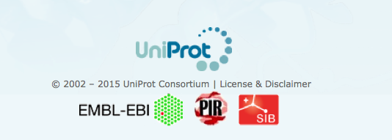
Course on Protein Networks and Systems Biology
UniProt
Uniprot is the highest quality and most accurately annotated protein sequence database.
A non redundant protein database, with maximal coverage including splice isoforms, disease variant and PTMs.
Easy protein identification, stable identifiers and consistent nomenclature/controlled vocabularies.
Detailed information on protein function, biological processes, molecular interactions and pathways cross-referenced to external source

Slide 15
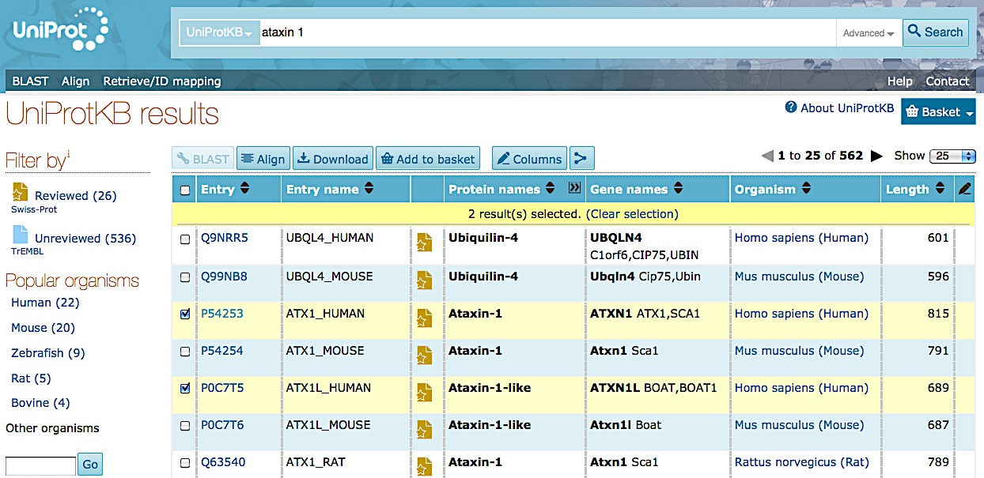
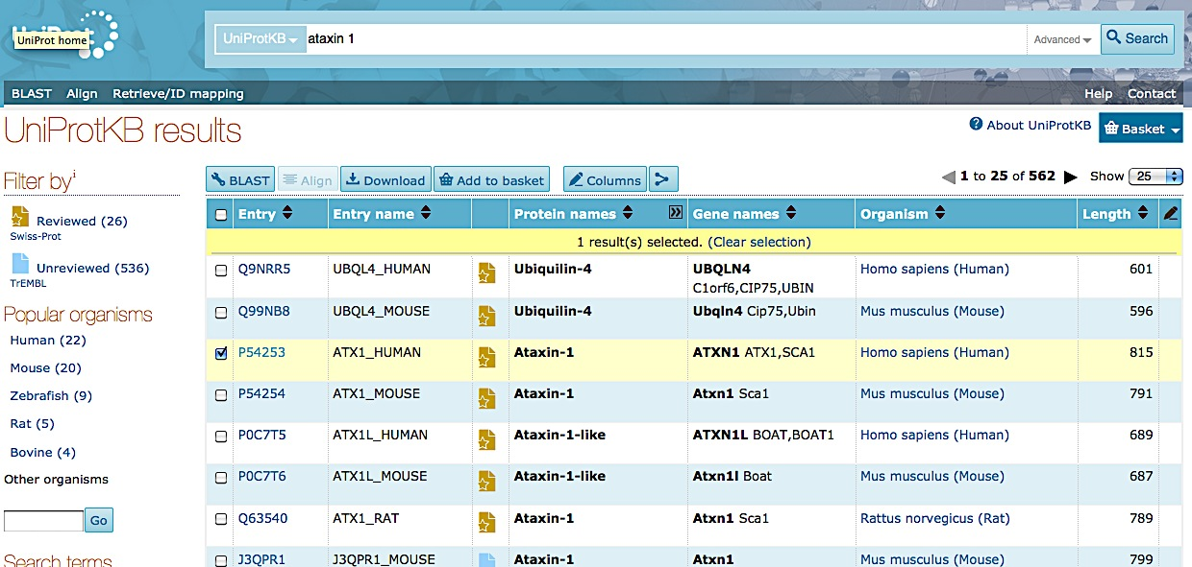
Course on Protein Networks and Systems Biology
UniProt Search

Slide 16
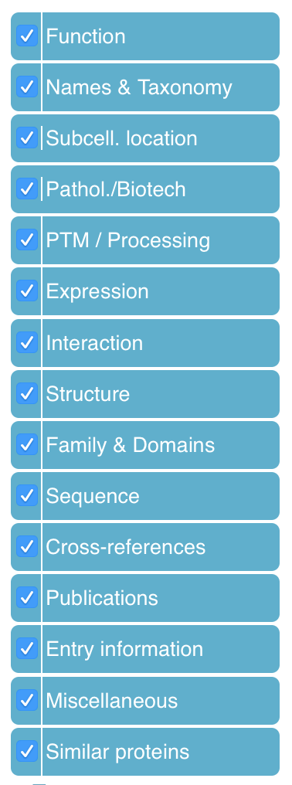
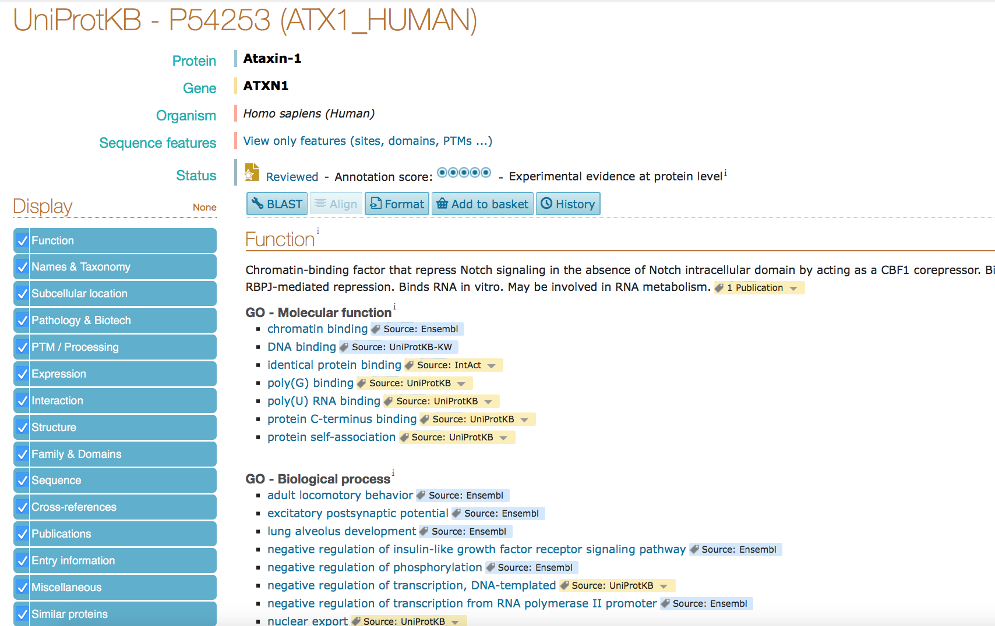
Course on Protein Networks and Systems Biology
PROTEIN INFORMATION

Slide 17
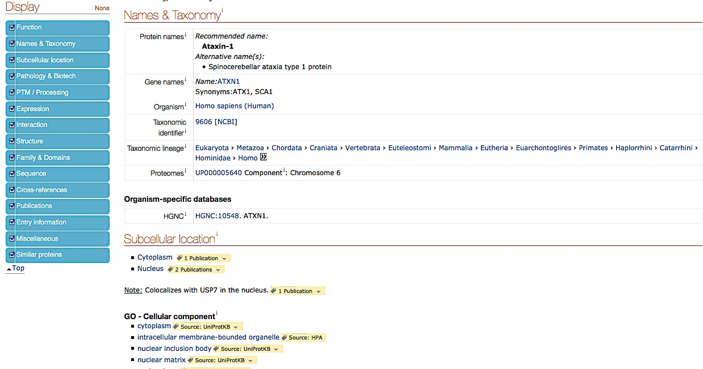
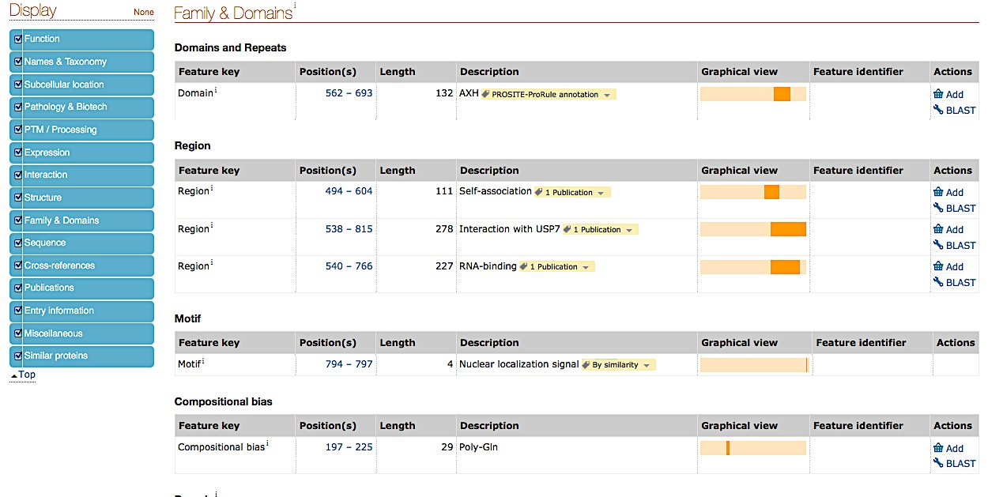
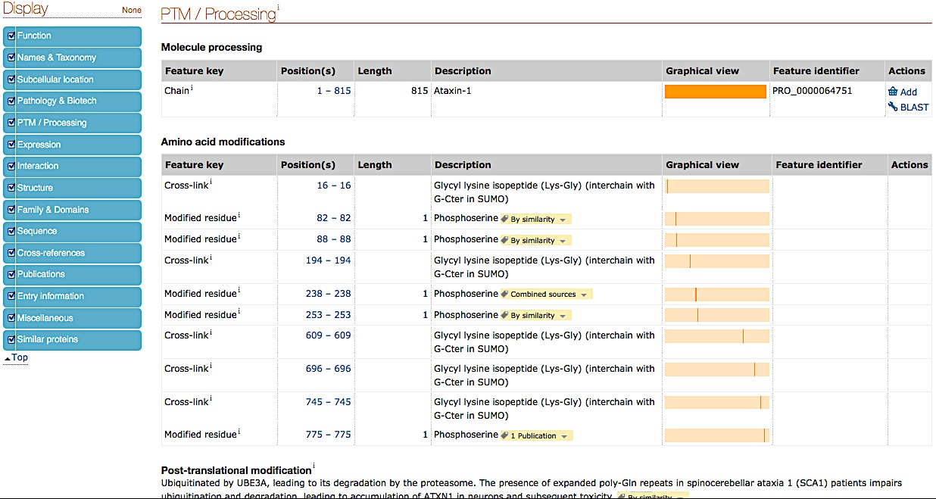
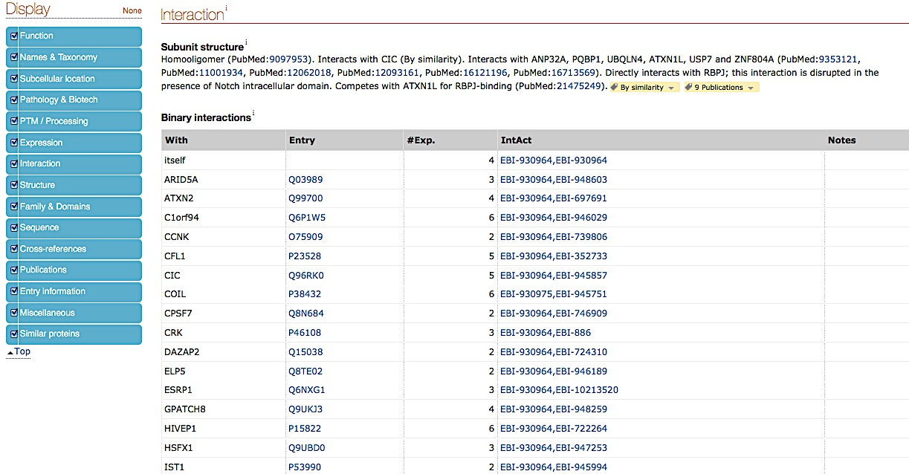
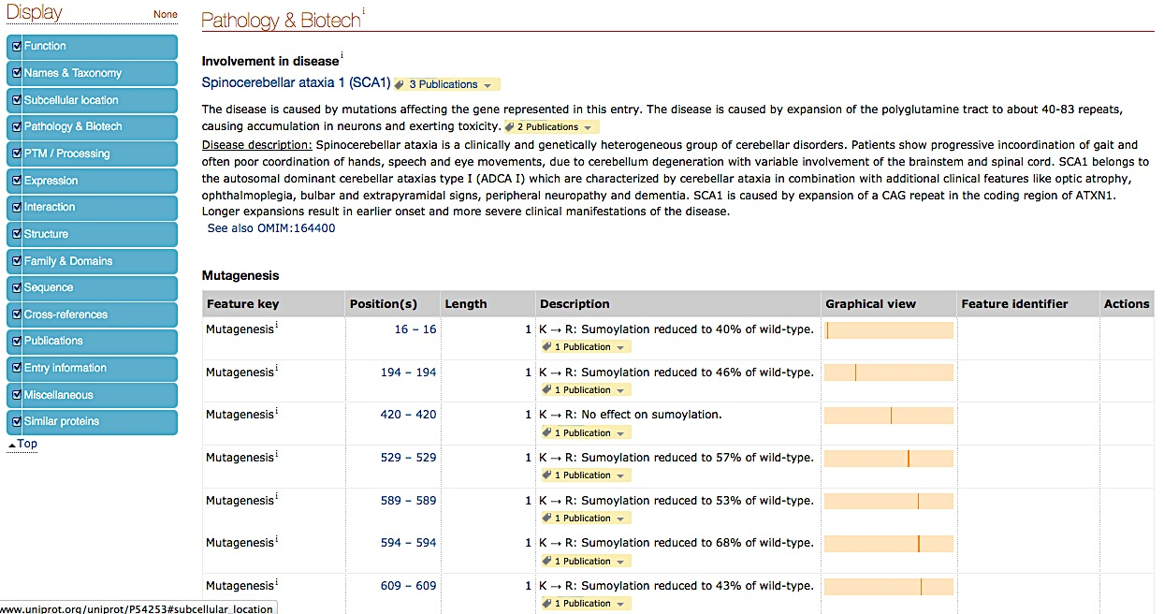
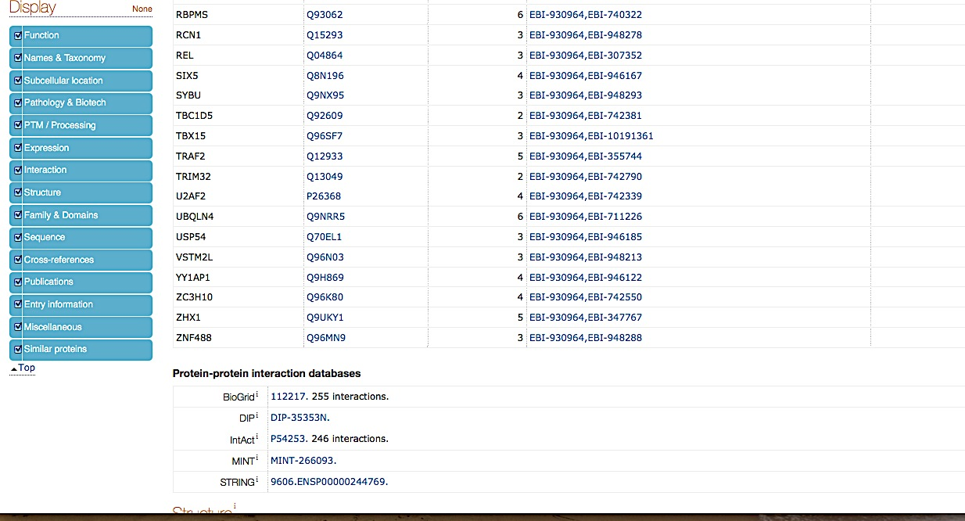
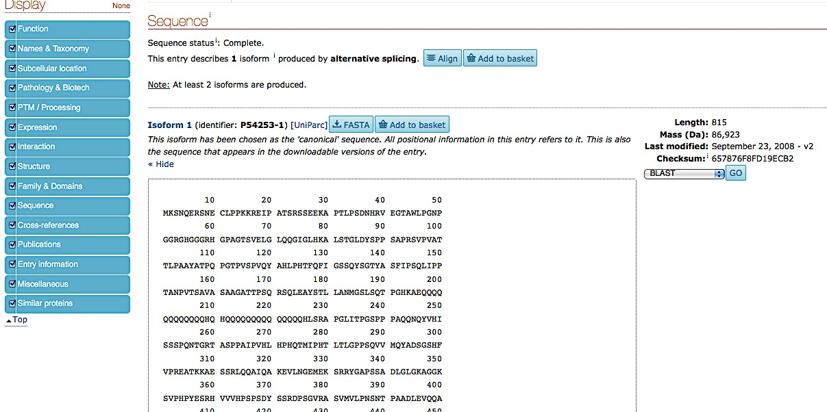
Course on Protein Networks and Systems Biology
GOING IN DETAILS…

Slide 18
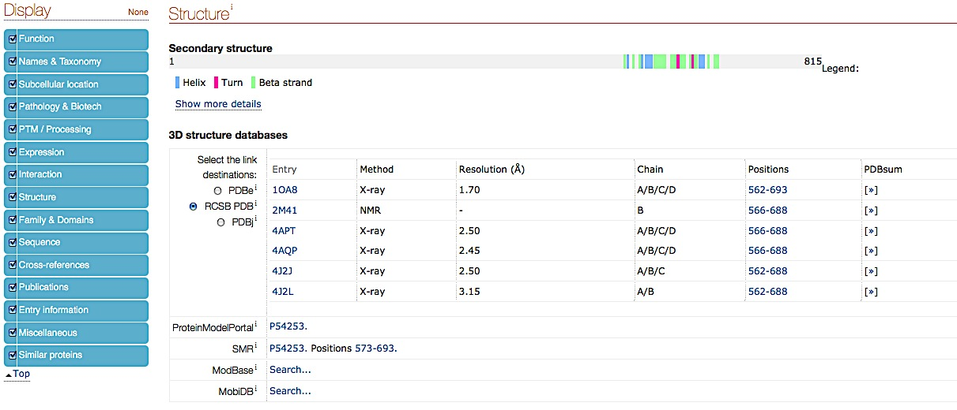
Course on Protein Networks and Systems Biology
STRUCTURAL INFORMATION IN UNIPROT

Slide 19
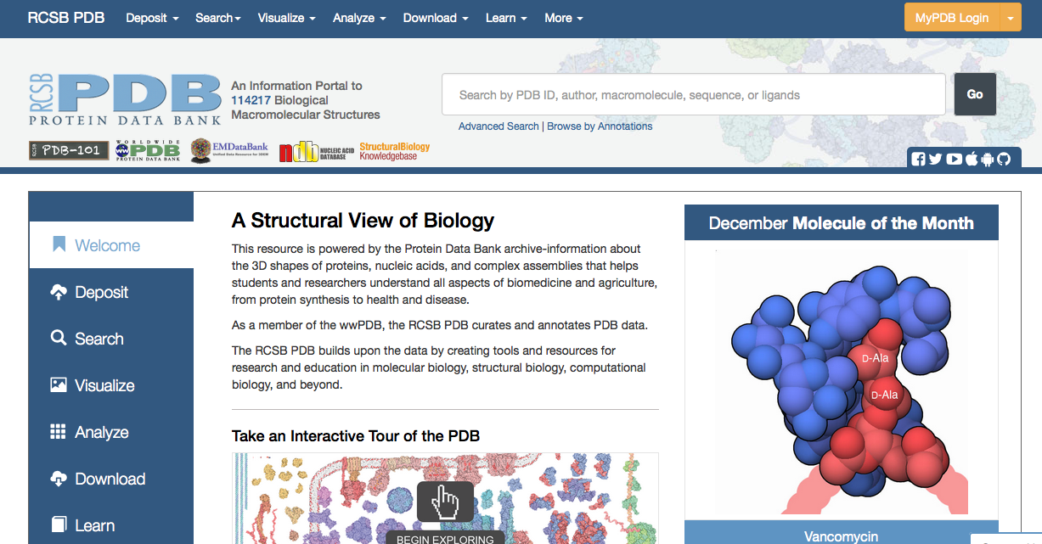
Course on Protein Networks and Systems Biology
PROTEIN DATA BANK (PDB)
PDB is an portal promoting exploration in the world of proteins and nucleic acids.
Along with our Worldwide PDB collaborators, RCSB PDB curates, annotates, and makes publicly available the PDB data deposited by scientists around the globe.
The RCSB PDB provides a window to these data through a rich online resource with powerful searching, reporting, and visualization tools for researchers.

Slide 20
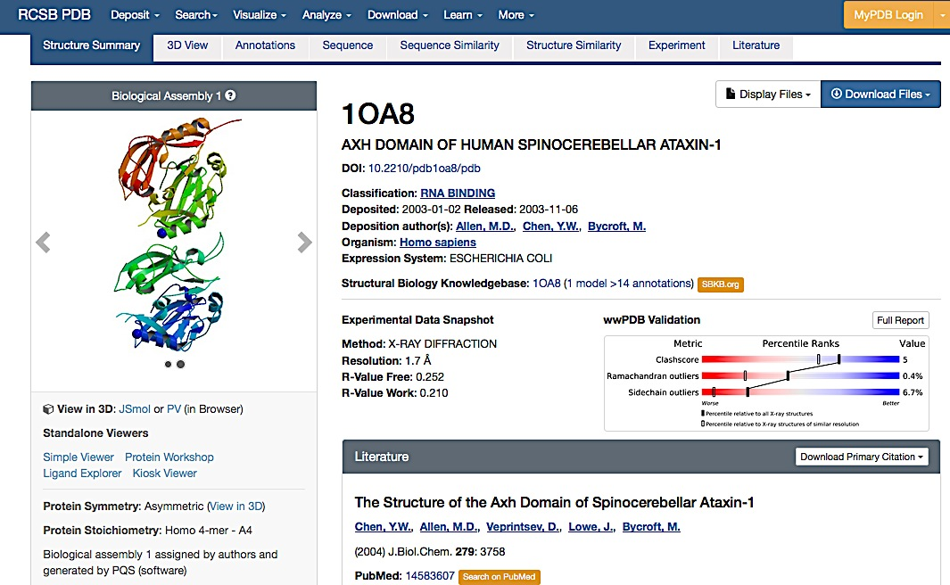
Course on Protein Networks and Systems Biology
PDB:1OA8

Slide 21
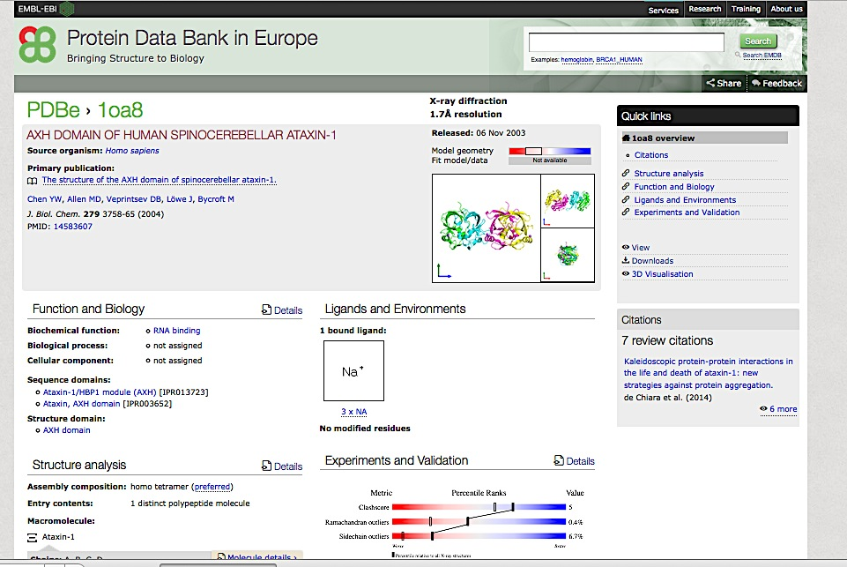
Course on Protein Networks and Systems Biology
PDBe

Slide 22
Course on Protein Networks and Systems Biology
Map proteins into UniProt reference sequence database
UniProtKB is the protein sequence reference database chosen by the majority of the interaction databases.
Choosing UniProtKB allow the curators to annotate:
the specific isoform utilized in an experiment
to describe all isoforms simultaneously (using the canonical sequence)
To specify a peptide, resulting from a post-translational cleavage.
Uniprot mapping tool allow users to convert several proteins identifiers to UniProt ACs

Slide 23
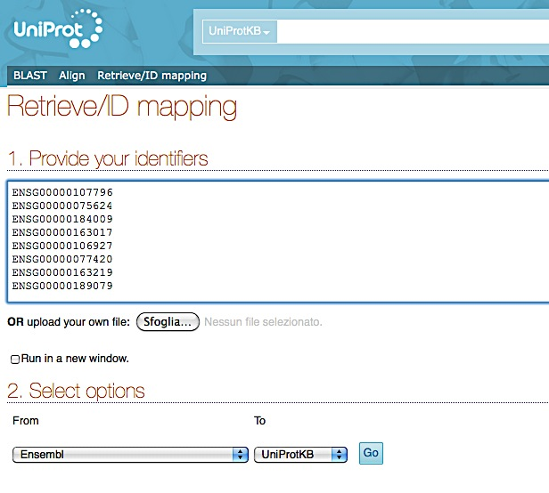
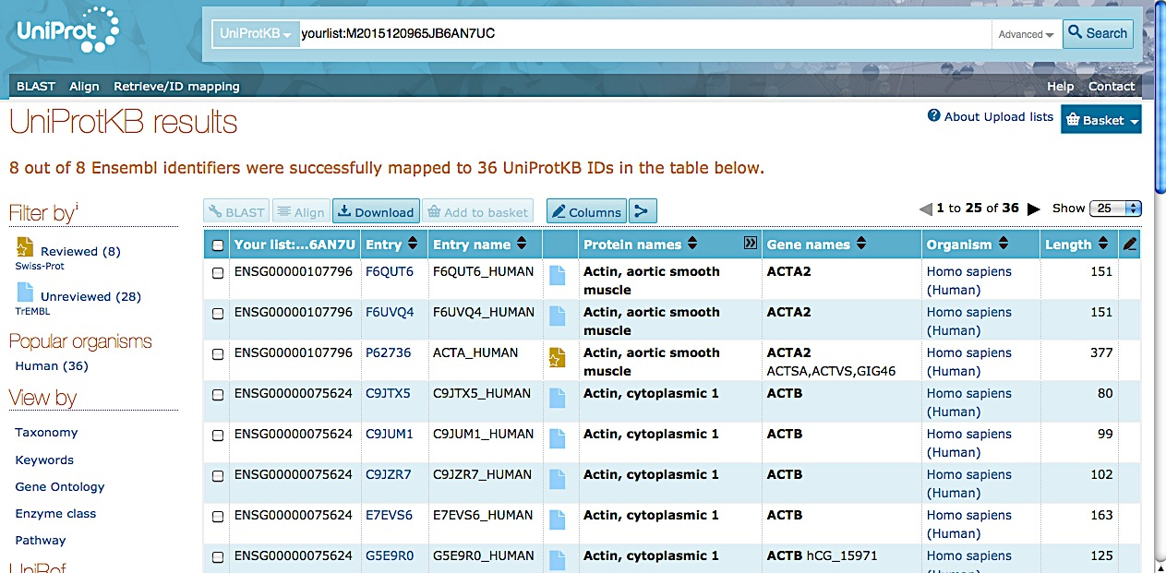
Course on Protein Networks and Systems Biology
Uniprot Retrieve/ID mapping

Slide 24
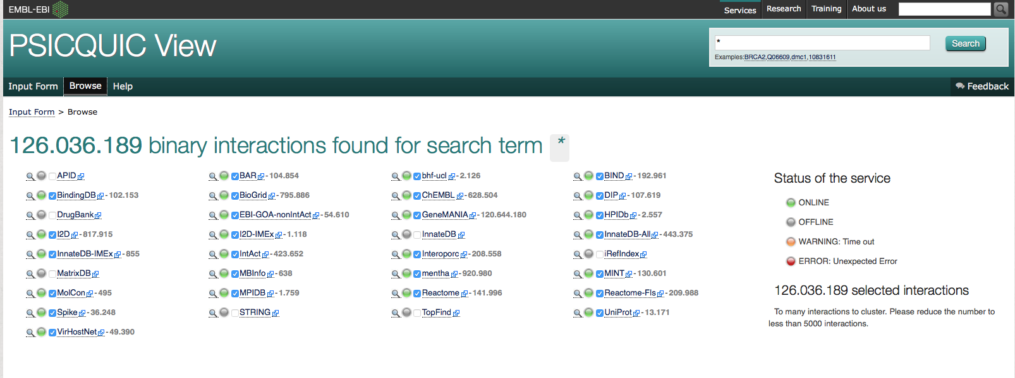
Course on Protein Networks and Systems Biology
PSICQUIC (PSI Common Query Interface)
PSICQUIC is an effort from the HUPO Proteomics Standard Initiative (HUPO-PSI) to standardize the access to molecular interaction databases programmatically.
It is available at:
http://www.ebi.ac.uk/Tools/webservices/psicquic/view/main.xhtml
and users can obtain results both in MITAB 2.5, 2.6 and 2.7 or PSI-XML formats using the MIQL 2.7 query language

Slide 25
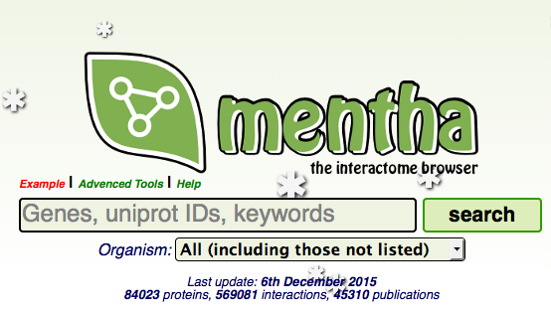
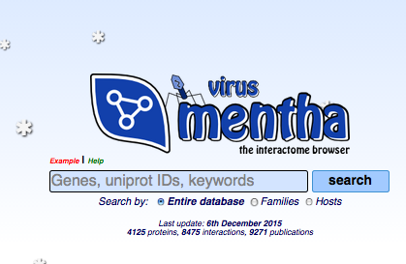
Course on Protein Networks and Systems Biology
MENTHA and VIRUS MENTHA
An interactome browser that offers protein-protein physical/enzymatic interaction information integrated from various sources. Its data comes from manually curated protein-protein interaction databases
virus mentha archives evidence about viral protein-protein interactions Viruses vs Hosts and viceversa - evidence collected from different databases that have adhered to the IMEx consortium.

Slide 26

Course on Protein Networks and Systems Biology
Questions???

Slide 27
Course on Protein Networks and Systems Biology
Practical 2: Web resources describing results of PPI experiments
Training session: Searching UniProt,
In this training session you will use UniProt database.
perform different search
check the cross-references
look for the PDB information
look for the PPIs information
Step2: UniProt and PDB
Step3: UniProt and PPI
Step4: Protein isoforms

Slide 28
Course on Protein Networks and Systems Biology
References
Taylor CF, Hermjakob H, Julian RK, Garavelli JS, Aebersold R, Apweiler R (2006) The work of the Human Proteome Organisation’s Proteomics Standards Initiative (HUPO PSI). OMICS 10:145–51. doi: 10.1089/omi.2006.10.145
Hermjakob H, Montecchi-Palazzi L, Bader G, Wojcik J, Salwinski L, Ceol A, Moore S, Orchard S, Sarkans U, von Mering C, Roechert B, Poux S, Jung E, Mersch H, Kersey P, Lappe M, Li Y, Zeng R, Rana D, Nikolski M, Husi H, Brun C, Shanker K, Grant SGN, Sander C, Bork P, Zhu W, Pandey A, Brazma A, Jacq B, Vidal M, Sherman D, Legrain P, Cesareni G, Xenarios I, Eisenberg D, Steipe B, Hogue C, Apweiler R (2004) The HUPO PSI’s molecular interaction format--a community standard for the representation of protein interaction data. Nat Biotechnol 22:177–83. doi: 10.1038/nbt926
Orchard S, Kerrien S, Abbani S, Aranda B, Bhate J, Bidwell S, Bridge A, Briganti L, Brinkman FSL, Brinkman F, Cesareni G, Chatr-aryamontri A, Chautard E, Chen C, Dumousseau M, Goll J, Hancock REW, Hancock R, Hannick LI, Jurisica I, Khadake J, Lynn DJ, Mahadevan U, Perfetto L, Raghunath A, Ricard-Blum S, Roechert B, Salwinski L, Stümpflen V, Tyers M, Uetz P, Xenarios I, Hermjakob H (2012) Protein interaction data curation: the International Molecular Exchange (IMEx) consortium. Nat Methods 9:345–50. doi: 10.1038/nmeth.1931
The Universal Protein Resource (UniProt) 2009. Nucleic Acids Res 37:D169–74. doi: 10.1093/nar/gkn664
Kerrien S, Orchard S, Montecchi-Palazzi L, Aranda B, Quinn AF, Vinod N, Bader GD, Xenarios I, Wojcik J, Sherman D, Tyers
M, Salama JJ, Moore S, Ceol A, Chatr-Aryamontri A, Oesterheld M, Stümpflen V, Salwinski L, Nerothin J, Cerami E, Cusick
ME, Vidal M, Gilson M, Armstrong J, Woollard P, Hogue C, Eisenberg D, Cesareni G, Apweiler R, Hermjakob H (2007) Broadening the horizon-- level 2.5 of the HUPO-PSI format for molecular interactions. BMC Biol 5:44. doi: 10.1186/1741-7007-5-44
Aranda B, Blankenburg H, Kerrien S, Brinkman FSL, Ceol A, Chautard E, Dana JM, De Las Rivas J, Dumousseau M, Galeota E, Gaulton A, Goll J, Hancock REW, Isserlin R, Jimenez RC, Kerssemakers J, Khadake J, Lynn DJ, Michaut M, O’Kelly G, Ono K, Orchard S, Prieto C, Razick S, Rigina O, Salwinski L, Simonovic M, Velankar S, Winter A, Wu G, Bader GD, Cesareni G, Donaldson IM, Eisenberg D, Kleywegt GJ, Overington J, Ricard-Blum S, Tyers M, Albrecht M, Hermjakob H (2011) PSICQUIC and PSISCORE: accessing and scoring molecular interactions. Nat Methods 8:528–9. doi: 10.1038/nmeth.1637
del-Toro N, Dumousseau M, Orchard S, Jimenez RC, Galeota E, Launay G, Goll J, Breuer K, Ono K, Salwinski L, Hermjakob
H (2013) A new reference implementation of the PSICQUIC web service. Nucleic Acids Res 41:W601–6. doi:
10.1093/nar/gkt392
Calderone A, Castagnoli L, Cesareni G (2013) mentha: a resource for browsing integrated protein-interaction networks. Nat Methods 10:690–1. doi: 10.1038/nmeth.2561
Calderone A, Licata L, Cesareni G (2015) VirusMentha: a new resource for virus-host protein interactions. Nucleic Acids Res 43:D588–92. doi: 10.1093/nar/gku830
Mayer G, Jones AR, Binz PA, Deutsch EW, Orchard S, Montecchi-Palazzi L, Vizcaíno JA, Hermjakob H, Oveillero D, Julian R, Stephan C, Meyer HE, Eisenacher M., Controlled vocabularies and ontologies in proteomics: overview, principles and practice. Biochim Biophys Acta. 2014 Jan;1844(1 Pt A):98-107. doi: 10.1016/j.bbapap.2013.02.017. Epub 2013 Feb 19. Review.
Orchard S., Data standardization and sharing-the work of the HUPO-PSI. Biochim Biophys Acta. 2014 Jan;1844(1 Pt A):82-7. doi: 10.1016/j.bbapap.2013.03.011. Epub 2013 Mar 20. Review.

